Slide 1
US Regional Collaboration and Economic Growth: A
Midwestern Case Study and a National Cross-Sectional
Analysis
By Davis Heniford

Slide 3
INTRODUCTION

Slide 4
Hayek’s Knowledge Problem

Slide 5
Hayek’s Knowledge Problem
One person’s knowledge is only a small fraction of the total of knowledge held by all members of society
Therefore, a decentralized economy complements the dispersed nature of information spread throughout society
Many small, fragmented municipalities are better in order to provide the right level of public goods for the citizen

Slide 6
Buchanan's Leviathan Model
The same basic motivational assumptions should be ascribed to market agents and political agents
Policymakers have some discretion over policy choice: it is difficult otherwise to explain a market for policy advisors.
The government is assumed to act as a monopolist that maximizes tax revenues
Many small, local governments competing through tax levels and services should eliminate this monopoly problem and furthermore promote efficiency

Slide 7
Buchanan’s Leviathan Model

Slide 8
Counterpoint: Economies of Scale

Slide 9
Fragmentation vs. Consolidation
Efficiency
Economy of scale vs. monopoly rents
Democracy
Smaller governments should more accurately and effectively represent their constituents
Distribution
Having many small municipalities can create inequities between them – more equity when similar services are given to all.
Development
Coordinating economic development efforts is difficult with rent seeking and too many barriers, but challenging with a too large and dispersed area

Slide 10
Potential Benefits of Collaboration
Development
Rent-seeking activities are a form of harmful development competition – includes sniping of businesses and incentive offers
Coordination of development knowledge and resources
Efficiency
small regional governments can avoid Buchanan and Hayek’s problems on some issues
Not fighting over tax base issues and instead collaboratively providing goods or services in some areas

Slide 11
DATA AND METHODS

Slide 12
Why National Units Don’t Work
Difficult to construct a fully developed functional specification for an economic regression using national units
Boundaries of these countries can be arbitrary
The countries themselves can be heterogeneous
Sample size will be limited

Slide 13
Independent Variables
Data from International City/County Management Association (ICMA) local government dataset
Two primary variables of interest to measure ‘regional collaboration’
Level of cooperation or competition for economic development and tax base among local governments in the region
Level of cooperation between the city and county government in creating the economic plan for the region

Slide 14
Dependent Variables
Data from U.S. Federal Bureau of Labor Statistics county and city data
Two primary variables of interest to measure economic growth
Percent growth in establishment count
Percent growth in employment
If we assume the competitiveness of domestic labor markets, employers in regions with lower quality of life will have to compensate workers with a higher salary. This confounding factor complicates the use of per capita income as the dependent variable

Slide 15
CASE STUDY

Slide 16
Case Study
Interviewed leaders of regional economic development agencies
Emphasized the importance of regional collaboration
A focus on improving quality of life
A focus on quick adaptation in response to regional economic issues
Interviewed representatives from regional firms
Workforce development needs
The burden of taxes
When prompted, business leaders generally agreed that regional collaboration was important
factionalism among local governments hurts a metropolitan area’s ability to draw in business with a united front
regional collaboration allowed for better usage of resources

Slide 17
EMPIRICAL STUDY

Slide 18
Regression #1

Slide 19
Confidence Interval

Slide 20
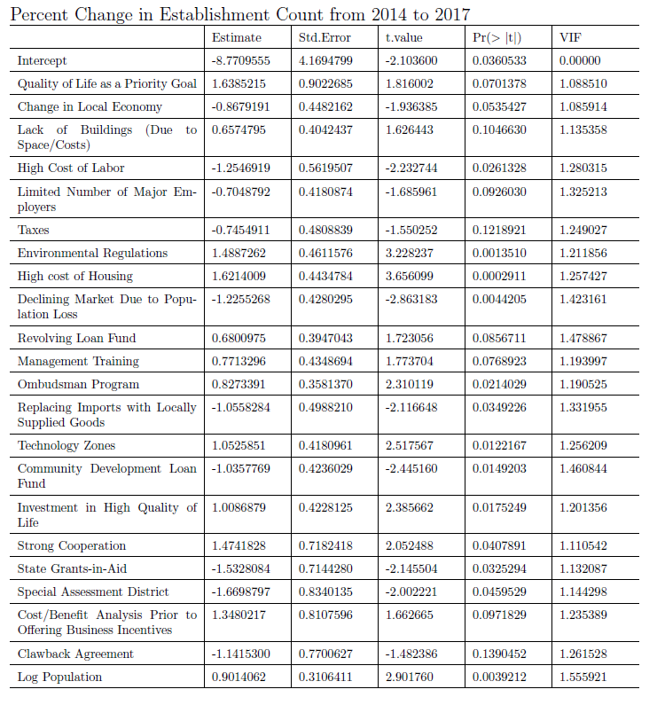
Regression #2

Slide 21
Confidence Interval

Slide 22
CONCLUSIONS

Slide 23
Concluding Remarks
This is the first empirical analysis of the relationship between regional collaboration and economic growth using a mix of U.S. county and city data
Some level of regional collaboration, at least when it comes to tax issues, has positive economic results
Additionally, regional competition over tax base and economic development does not help economic outcomes
However, city-county collaboration on economic development plans also does not benefit regions

Slide 24
Limitations
Collaboration could be viewed as the formation of an oligopolist which could create the same inefficiencies as a monopolist
Collaboration is operationalized poorly
Functional form poorly specified
Many of the variables included seem superfluous and there are important variables I left out
I don’t trust the case study method of acquiring an empirical model

Slide 25
Thank You

